Slide 1
Student road trip planner🌍
CAPSTONE PROJECT
Presented By:
Ruchita Maaran
Saveetha College of Liberal Arts and Sciences
BCA

Slide 2
OUTLINE
Problem Statement
System Development Approach
Algorithm
Deployment
Result
Conclusion
Future Scope
References

Slide 3
Problem Statement
In today’s fast-paced student life, planning a group trip can be overwhelming due to limited time, tight budgets, and lack of travel planning experience. Many students miss out on memorable getaways because estimating costs, finding suitable destinations, and organizing itineraries can be confusing and stressful. Traditional travel agencies often focus on general tourism rather than affordable, student-friendly experiences.
Problem: There is a critical need for an intuitive, budget-conscious, and personalized travel planning solution that empowers students to organize road trips efficiently. The system should estimate costs, suggest itineraries, and provide practical tips while catering to the group’s size, trip vibe, and mode of travel—making student getaways fun, memorable, and stress-free.

Slide 4
System DEVELOPMENT Approach
Frontend | Streamlit app for user interaction (chat UI, input/output display)
Backend | Python logic to handle chat flow, model inference, and session state
Model Engine | OpenRouter API (tngtech/deepseek-r1t2-chimera)
Data Handling | Optional logging, feedback collection, or prompt templates

Slide 5






ALGORITHM
Generate AI Trip Plan
Estimate Budget
Initialize App
Input estimated distance. Calculate travel, stay, food, and misc costs. Compute total and per-person budget.
On button click, create prompt with trip details. Send to OpenAI API (via OpenRouter). Display generated itinerary and handle errors.
Set page config, title, and intro sections.
01
02
03
04
05
06
Collect Trip Inputs
Display Budget
Finalize UI
Show category-wise breakdown in a table. Display total and per-person metrics. Visualize cost distribution using a pie chart.
Add dividers and app credits.
Get start & destination cities. Select number of people, trip days, travel mode, and vibe.

Slide 6
DEPLOYMENT
Availability
Host on reliable platforms (Streamlit Cloud/AWS). Minimize downtime; handle API errors smoothly.
Privacy & Security
Store API keys in st.secrets. Don’t log user data without consent. Use HTTPS and avoid exposing PII.
Performance
Keep calculations and charts fast. Optimize API calls for <3s response time.
Scalability
Modular structure for easy feature expansion. Support multiple users efficiently.
Usability
Mobile-friendly, intuitive layout. Use icons/emojis and clear feedback elements.

Slide 7
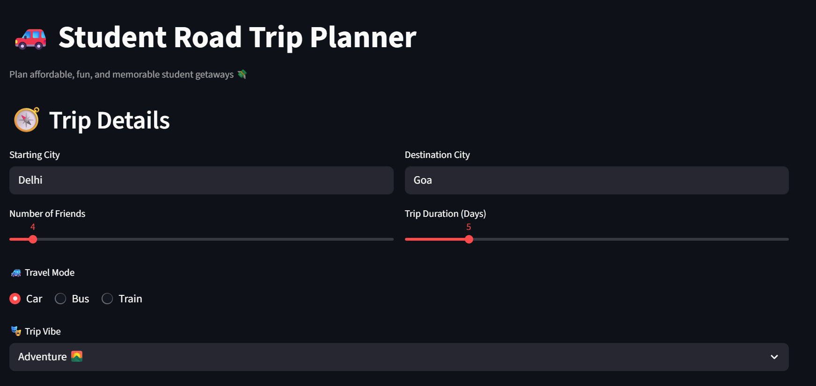
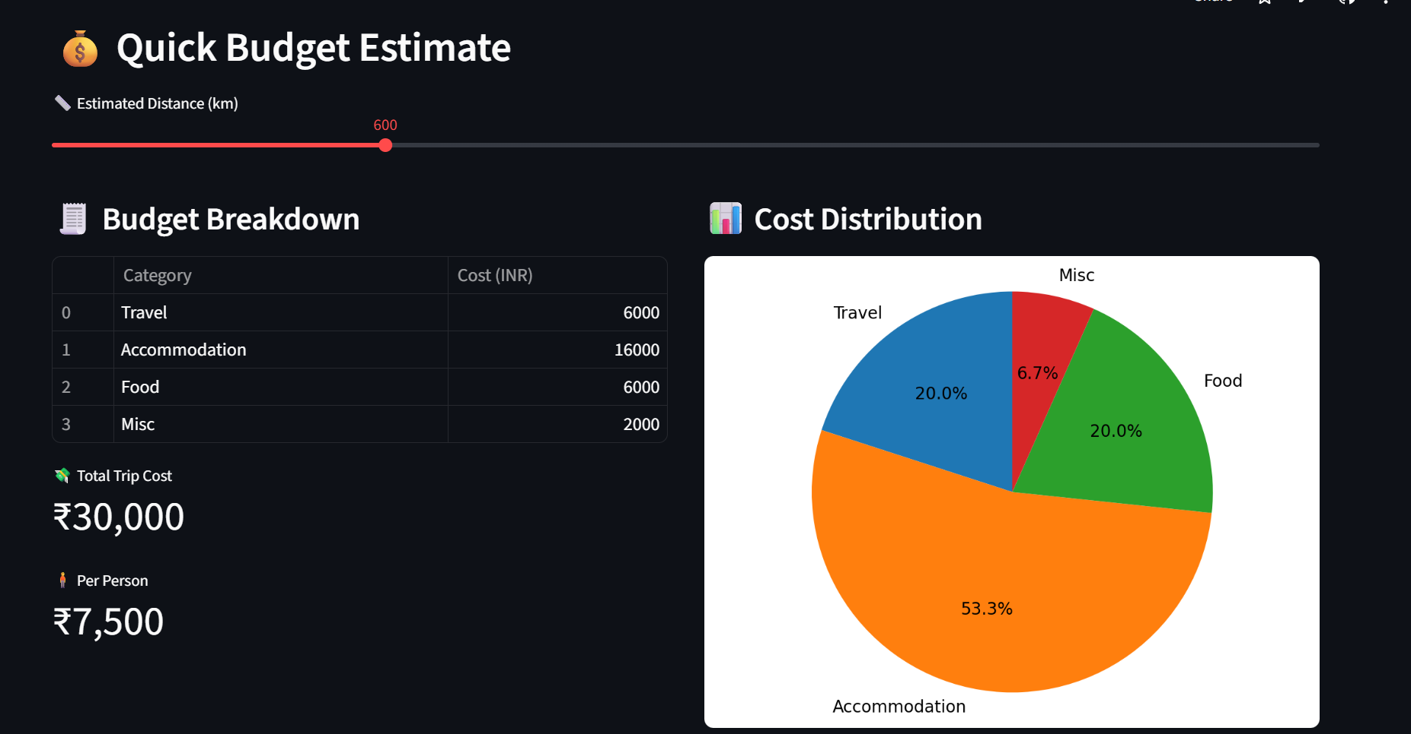
RESULT

Slide 8
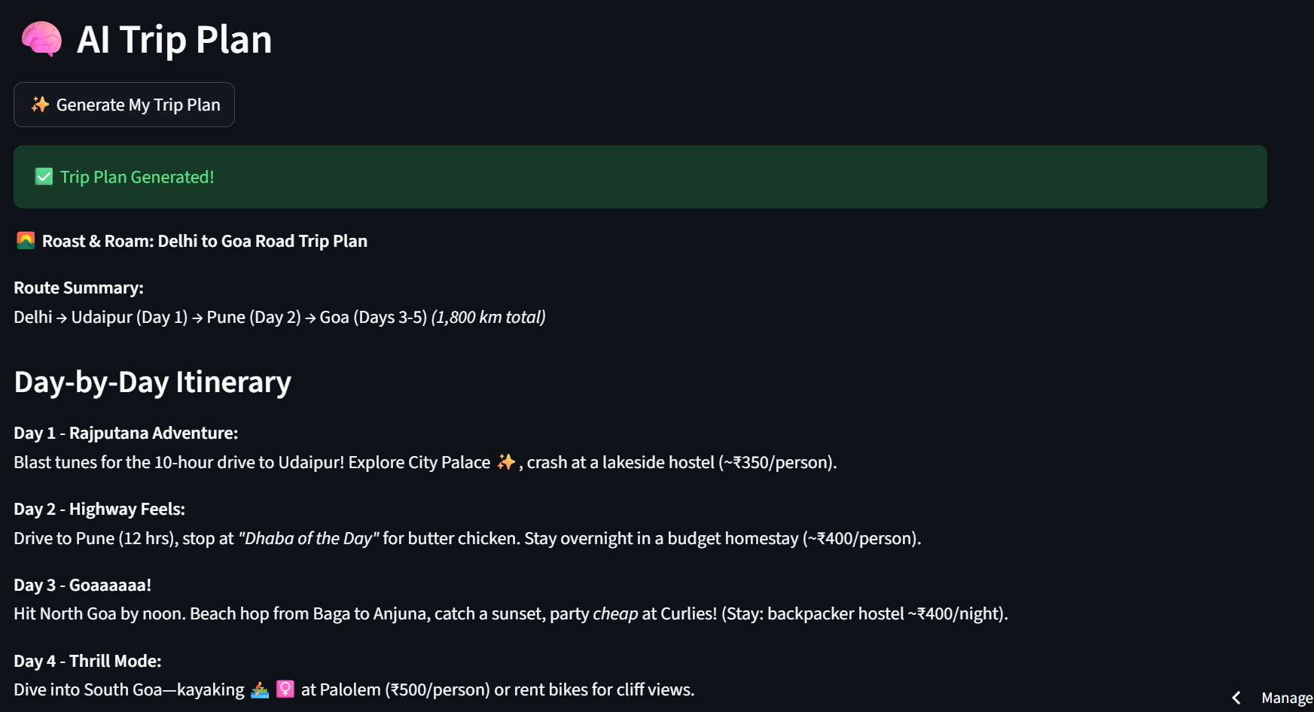
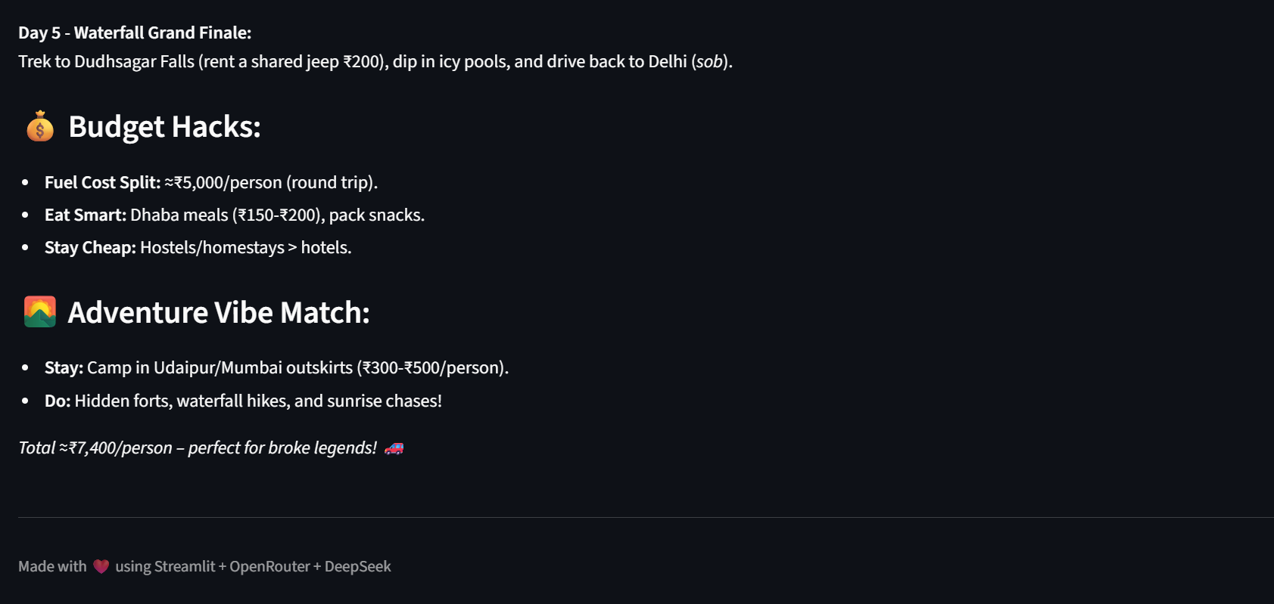
RESULT

Slide 9
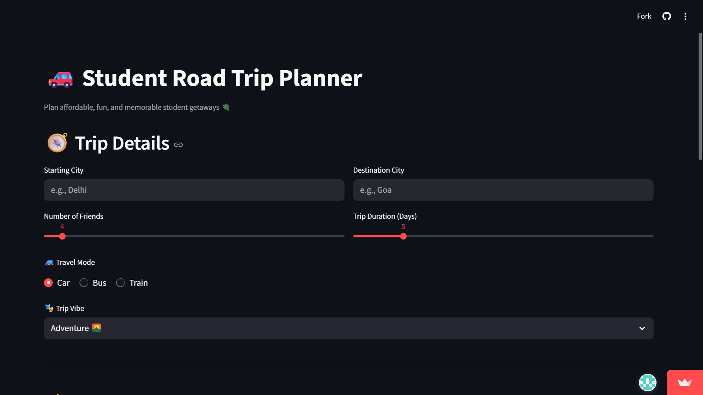
Result

Slide 10
GITHUB AND DEPLOYMNET LINK
Github Link :
https://github.com/WisteriaM7/STUDENT-ROAD-TRIP-PLANNER
Deployment link: STREAMLIT CLOUD
https://student-road-trip-planner.streamlit.app/

Slide 11
Conclusion
The development of the Student Road Trip Planner using Streamlit and OpenAI (via OpenRouter) showcases an innovative approach to simplifying travel planning for students.
By combining intuitive user inputs, real-time budget estimation, visual cost breakdowns, and AI-generated itineraries, the system transforms trip organization into a fun, interactive, and data-driven experience.
This project highlights how AI and modern web frameworks can empower students to plan affordable, well-structured, and memorable getaways with ease.

Slide 12
Future scope
Add Map Integration: Display live routes, distance, and estimated travel time using Google Maps or OpenStreetMap.
Include Real-Time Cost Data: Fetch dynamic prices for fuel, hotels, and transport using public APIs for accurate budgeting.
Personalized Recommendations: Suggest destinations, stays, and activities based on user preferences and past trips.
Multi-Language Support: Add regional languages (like Hindi, Tamil, Bengali) to make the planner accessible to more students.

Slide 13
References
https://github.com/WisteriaM7/STUDENT-ROAD-TRIP-PLANNER
https://streamlit.io/cloud
https://docs.streamlit.io/develop/api-reference/connections/st.secrets
https://docs.streamlit.io/develop/concepts/connections/secrets-management
https://docs.streamlit.io/deploy/streamlit-community-cloud/deploy-your-app/secrets-management

Slide 14
THANK YOU

